Slide 1
Particle Model

Slide 2
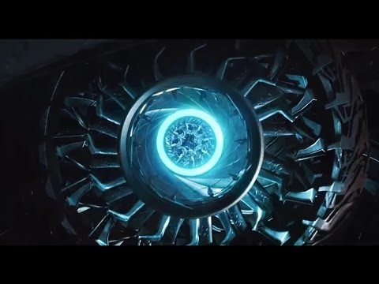

Slide 3
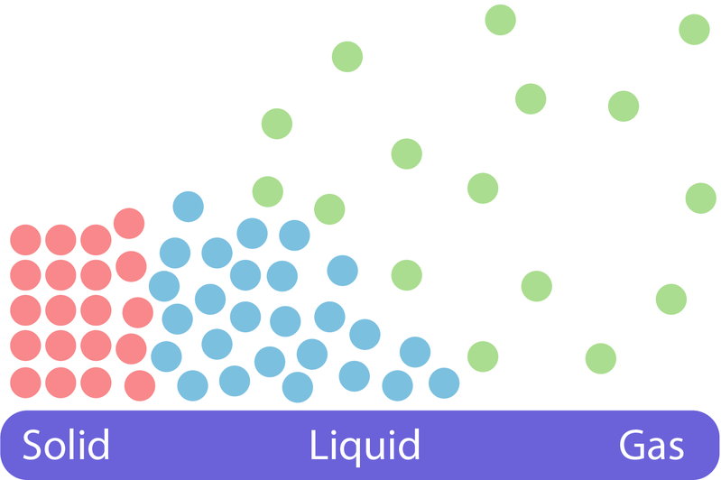
In this Smart Lesson you will learn to:
Describe the kinetic particle model of matter.
Recall the states of matter.

Slide 4

The kinetic particle model of matter states that all matter is made up of particles, which are in a constant state of motion.
Since the particles are moving, they must have a kinetic energy associated with them.
Particles also have potential energy. This energy is stored in the bonds between particles, and the amount of stored energy depends on the distance between the particles.

Slide 5

We can visualise the particle model as two hyperactive children who are tied together with a very long, very strong rubber band.
The children are the particles while the rubber band is the bond between them.
The children are running around, giving them kinetic energy. This relates back to the constant motion of particles.
When the children pull away from each other, they stretch the rubber band, storing potential energy in it. The more the rubber band is stretched, the more energy is stored.
The potential energy stored in the rubber band represents the potential energy stored in the bonds between particles.

Slide 6
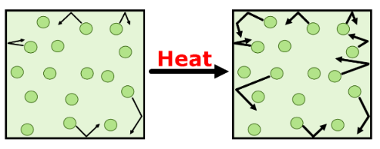
All particles have energy, but the amount of energy varies according to the temperature.
As temperature increases, the kinetic energy of the particles increases.
The temperature of a substance is a measure of the average kinetic energy of the particles.

Slide 7
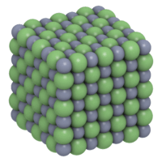
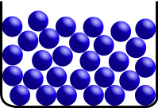
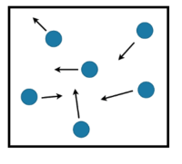
There are three main states of matter: solids, liquids and gases.
Solids are made up of particles which are tightly packed together. They have a fixed volume, fixed shape and are mostly incompressible.
Liquids are made up of particles which are loosely packed together. They do not have a fixed shape; they take on the shape of the container they are in. They do have a fixed volume and are more or less incompressible.
Gases are made up of particles which are free to move. They do not have a fixed shape or volume and are compressible.

Slide 8
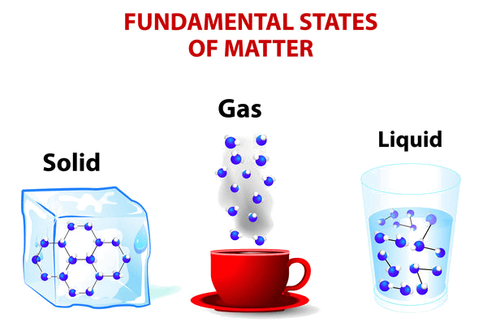
Energy in solids, liquids and gases.
Particles in solids have low kinetic energy. The particles are tightly bound, so can't move much, giving them a smaller kinetic energy.
Particles in liquids have a moderate amount of kinetic energy. This is because the particles can move more, giving them a greater kinetic energy.
Particles in gases have highest kinetic energy as the particles are moving quickly. In an ideal gas, there are no intermolecular forces. However, in a real gas there are weak intermolecular forces.

Slide 9
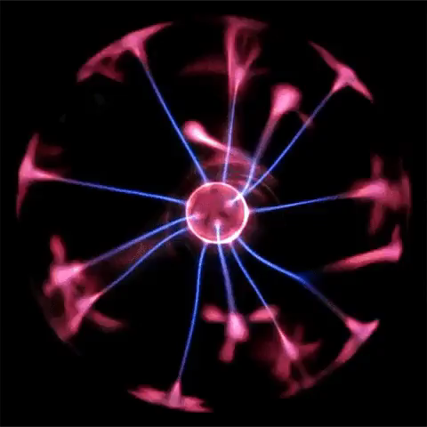
There are other states of matter, but they are not encountered as commonly in our day to day life.
Plasma is an example which is similar to gases, but has charged particles. It is important in stars as well as fluorescent lights, neon lights and plasma televisions.
Glass is a non-classical state which is non-crystalline and has very specific properties quite different to classical solids.
Liquid crystals have a state in between a fluid liquid and an ordered solid. They are used in liquid crystal displays (LCDs).
There are also some states that only exist close to absolute zero, such as superfluid and the Bose-Einstein condensate.

